Slide 1
MECM Requirement Analysis-v1.0

Slide 2
Requirements v0.9
Num | Content
1 | 1.“Application Package List” & “Application Package Distribution” should be merged into “Application Package Management”. 2.Check the distribution status of the application package for details, and support batch distribution 3.Deploy through the application package details interface, and support batch deployment
2 | 4.Supplement the ability to view deployment topology through the application, and optimize the display method.(Analyzing) 5.Add “topology” to the operation of application package management .(Analyzing) 6.Support pop up a new page to view the deployed node topology of the current application .(Analyzing) 7.When a node is selected in the topology, basic information such as the name and address of the node is displayed.
3 | 8.APPLCM should be optimized to be a modular display. Make it beautiful & support to search. 9.App store should be optimized into a modular display.

Slide 3
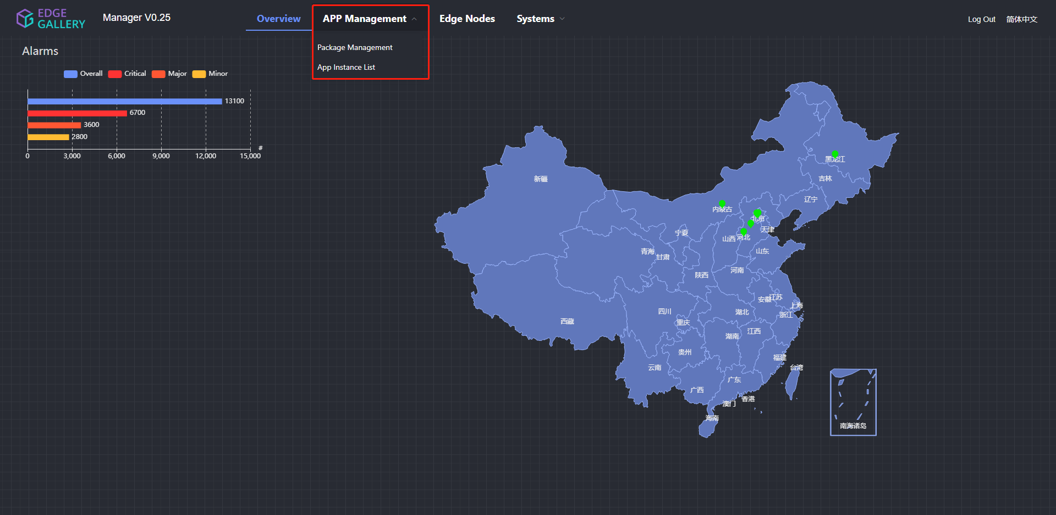
Requirements v1.0
1.“Application Package List” & “Application Package Distribution” should be merged into “Application Package Management”.

Slide 4
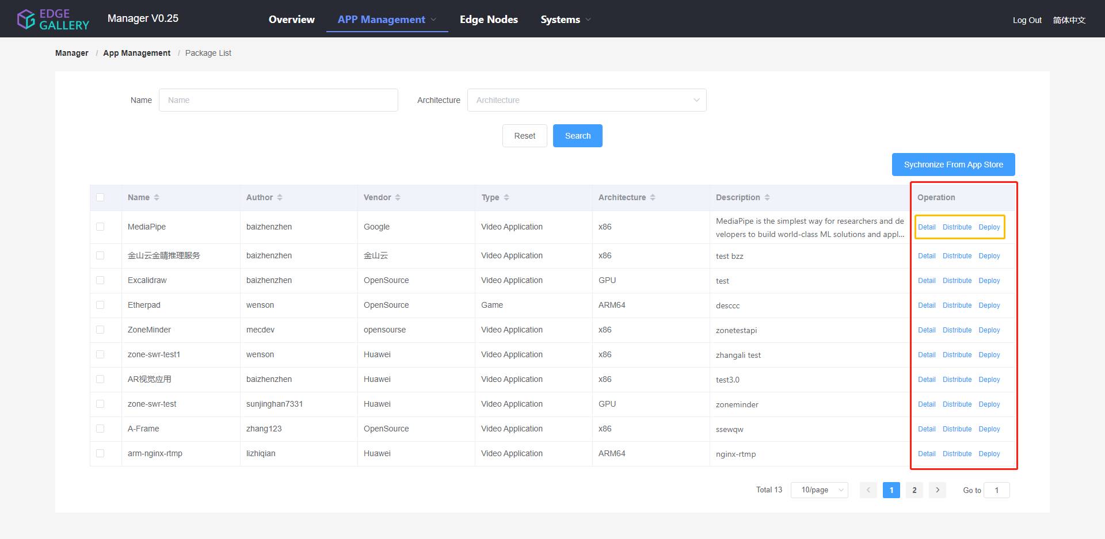
Requirements v1.0
2.Check the distribution status of the application package for details, and support batch distribution

Slide 5
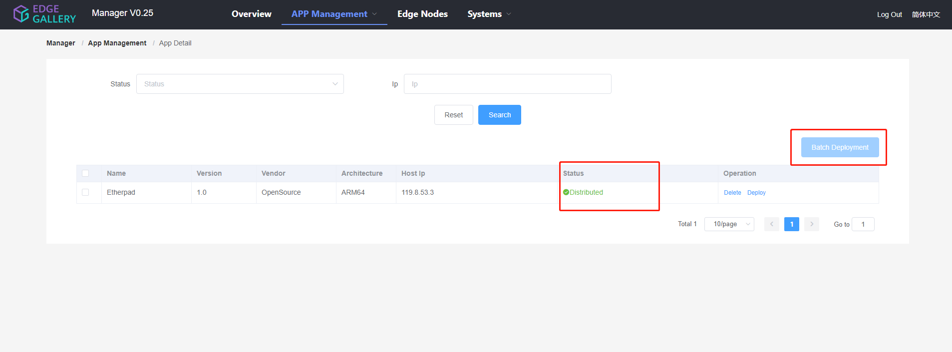
Requirements v1.0
3.Deploy through the application package details interface, and support batch deployment

Slide 6
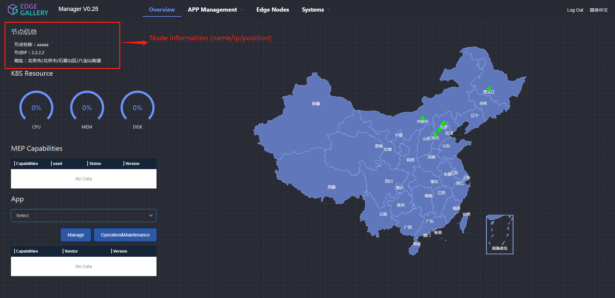
Requirements v1.0
7.When a node is selected in the topology, basic information such as the name and address of the node is displayed.

Slide 7
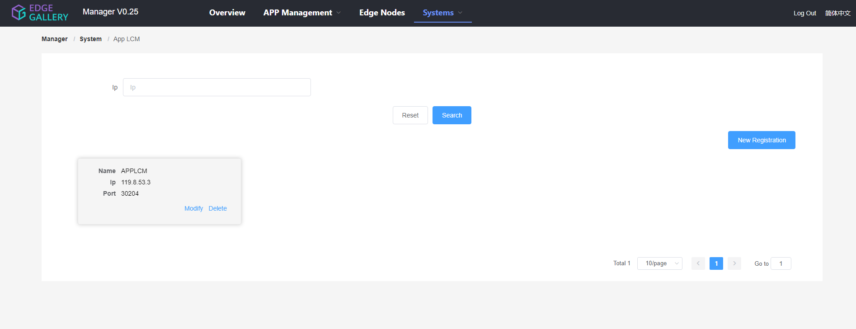
Requirements v1.0
8.APPLCM should be optimized to be a modular display. Make it beautiful & support to search.

Slide 8
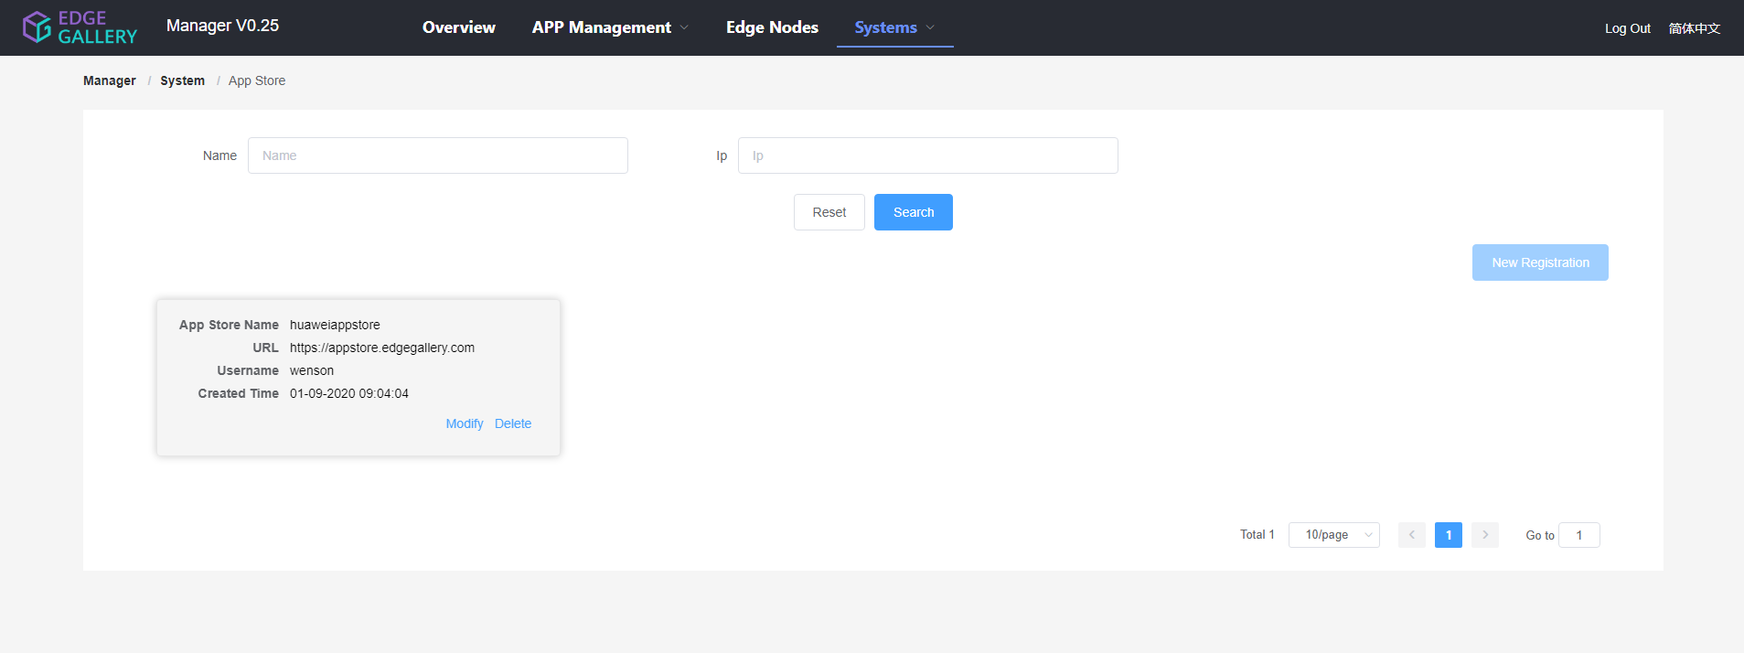
Requirements v1.0
9.App store should be optimized into a modular display.

Slide 9
Security Design Compliance Test
Content | Related Information
Security design rule ID | NA
Implementation details | NA
Related APIs | Inventory/APPO/APM
Example API payload | NA
Related files | Mecm-fe repo(system/external folder, app folder, overview folder, JavaScript files etc.)
Related GUI URLs | https://159.138.130.116:30093
GUI testing steps | Following the UI and Testing WG
GUI input example | NA
Additional Info | NA

